Slide 1
Large Language Models
CSCI 601 471/671
NLP: Self-Supervised Models
https://self-supervised.cs.jhu.edu/sp2023/
[Slide credit: Chris Tanner, Jacob Devlin and many others ]

Slide 2
Logistics Update
The midterm:
How was it?
HW6 is out!
No Google-colabs anymore!
You can do it as a team (one submission per team).
Please start the programming portion early!

Slide 3
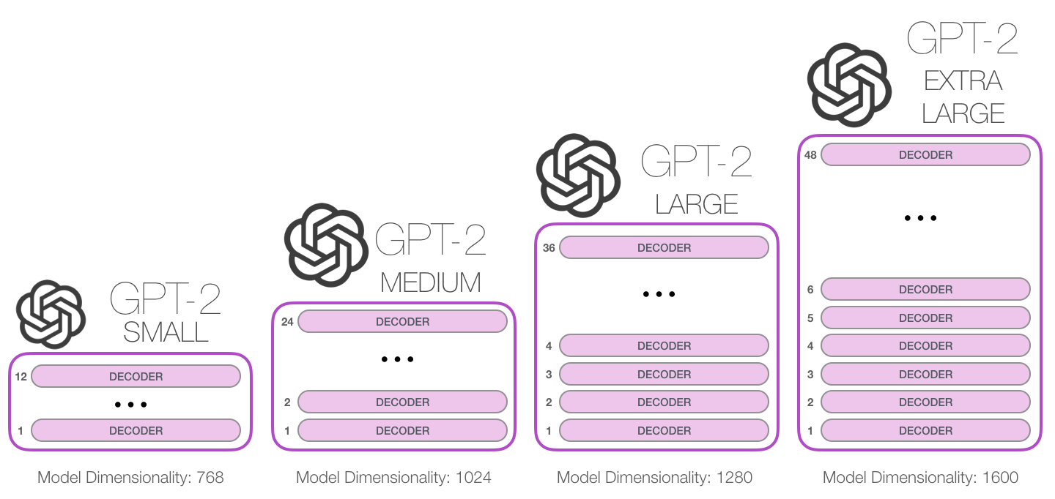
GPT2: Model Sizes
Play with it here: https://huggingface.co/gpt2
117M parameters
345M
762M
1542M
[Image by http://jalammar.github.io/illustrated-gpt2/]

Slide 4
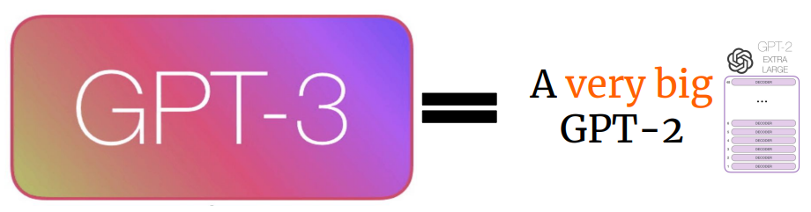
GPT-3: A Very Large Language Model (2020)
More layers & parameters
Bigger dataset
Longer training
Larger embedding/hidden dimension
Larger context window
[Slide credit: Sbhya Chhabria & Michael Tang]

Slide 5
GPT3: Try it yourself!
https://beta.openai.com/playground

Slide 6
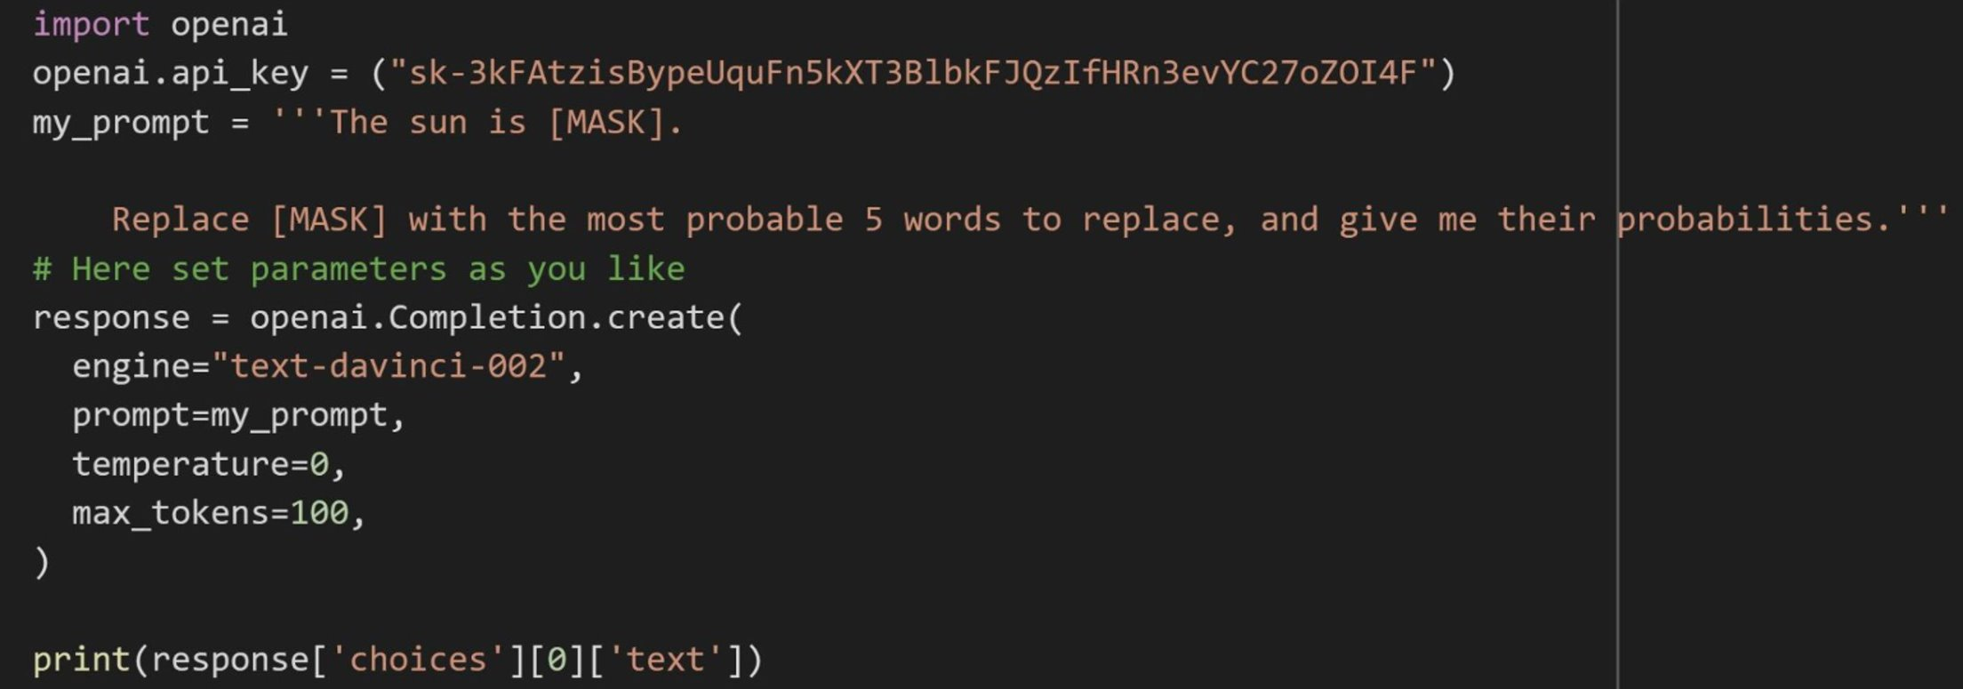

Slide 7
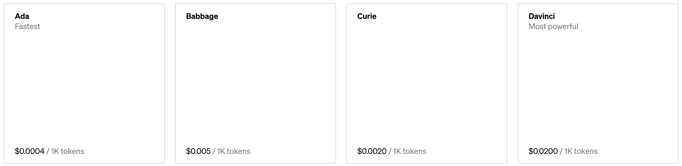
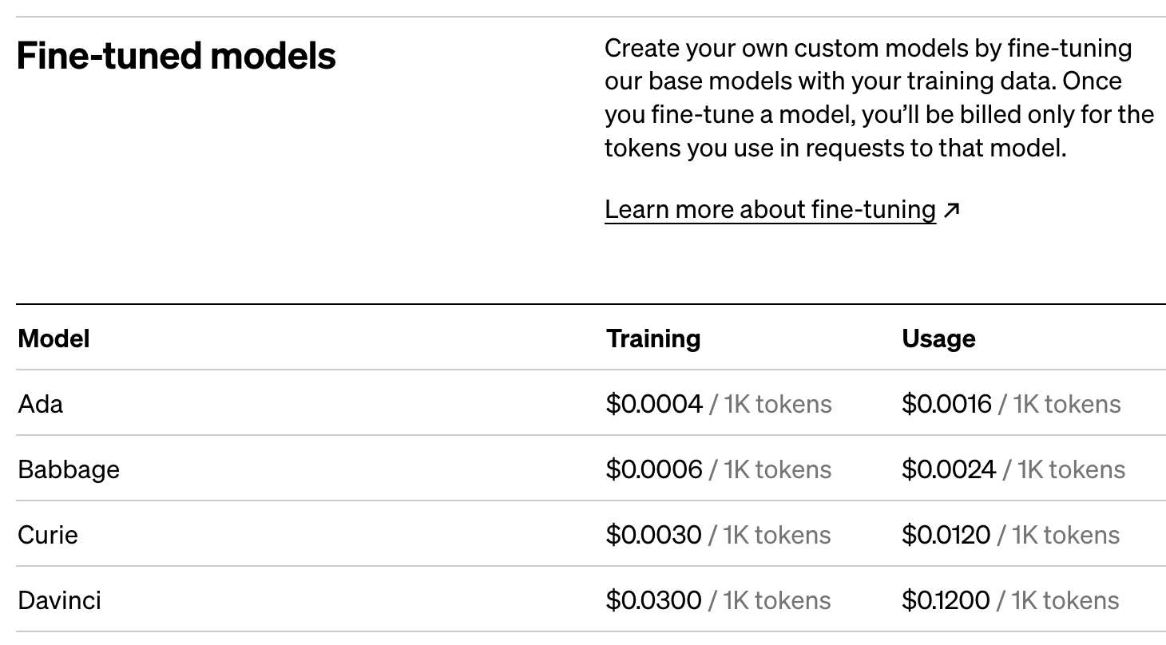
GPT3: Try it yourself!

Slide 8
Other Available [Decoder] LMs
EleutherAI: GPT-Neo (6.7B), GPT-J (6B), GPT-NeoX (20B)
Meta/Facebook: OPT (Open Pre-trained Transformer), various sizes up to 175B
BLOOM, 176B model
LLaMA, 65B
https://huggingface.co/EleutherAI
https://6b.eleuther.ai/
https://huggingface.co/facebook/opt-125m
https://huggingface.co/bigscience/bloom
https://github.com/facebookresearch/llama

Slide 9
In-context Learning
CSCI 601 471/671
NLP: Self-Supervised Models
https://self-supervised.cs.jhu.edu/sp2023/
[Slide credit: Iz Beltagy, Arman Cohan, Robert Logan IV, Sewon Min, Sameer Singh, and many others ]

Slide 10
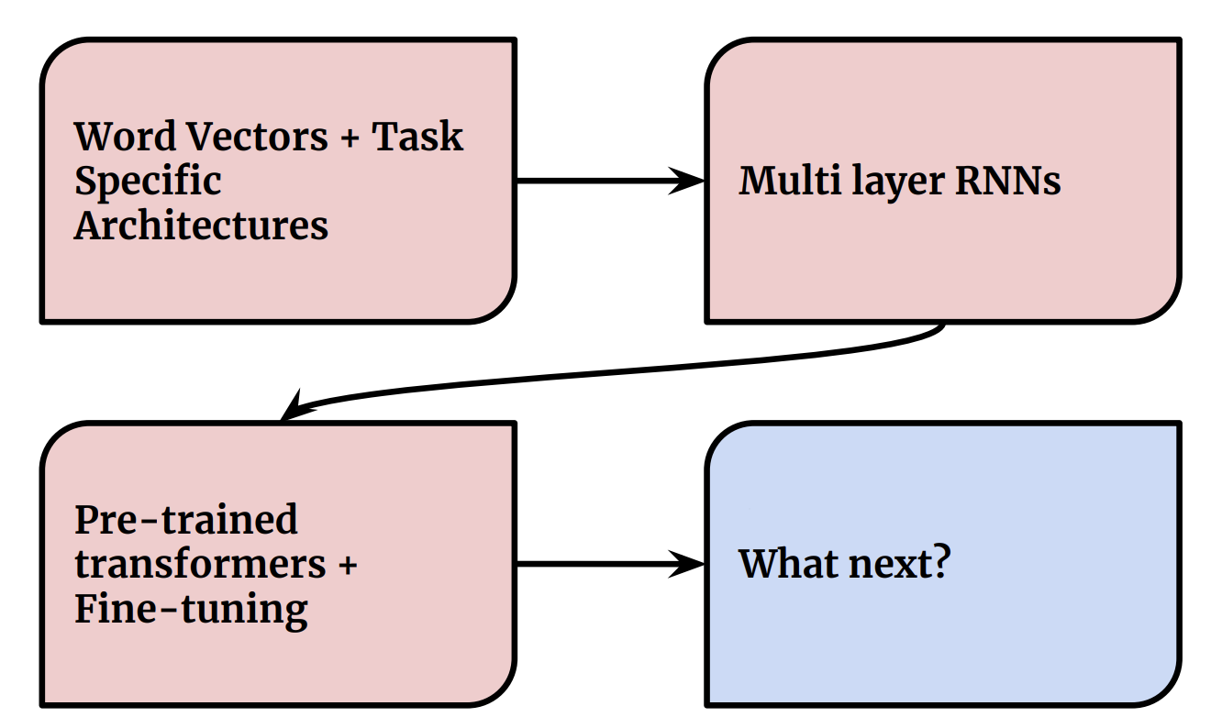
The Phases of Paradigms

Slide 11
“I have an extremely large collection of clean labeled data”
- No one
[Colin Raffel]

Slide 12
Limitations of Pre-training -> Fine-tuning
Often you need a large labeled data
Though more pre-training can reduce the need for labeled data
End up with many copies (or sub-copies) of the same model

Slide 13
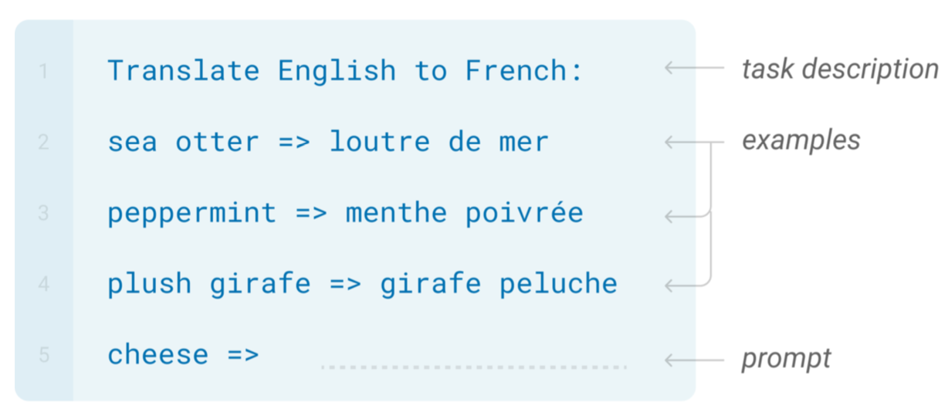
In-context Learning

Slide 14
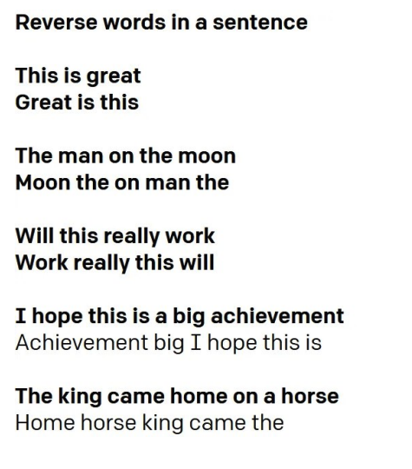
In-context Learning
https://gpt3experiments.substack.com/p/is-gpt-3-really-doing-few-shot-learning

Slide 15

In-context Learning

Slide 16
In-context Learning: Terminologies
Input to the LM
Prompt: A conditioning text coming before the test input
Demonstrations: A special instance of prompt which is a concatenation of the k-shot training data (in in-context learning, prompt==demonstrations)
(prompt can be a description about the task)
An effortlessly accomplished and richly resonant work. A mostly tired retread of several other mob tales.
A three-hour cinema master class.
It was great! It was terrible!
It was !
[ACL 2022 Tutorial Beltagy, Cohan, Logan IV, Min and Singh]

Slide 17
GPT3: Try it yourself!
https://beta.openai.com/playground

Slide 18
In-Context (Few Shot) Prompting
Popularized by GPT-3 (but predates that model)
Perform a task based on a few examples provided in the inference time.
The model identifies patterns in examples and replicates it

Slide 19
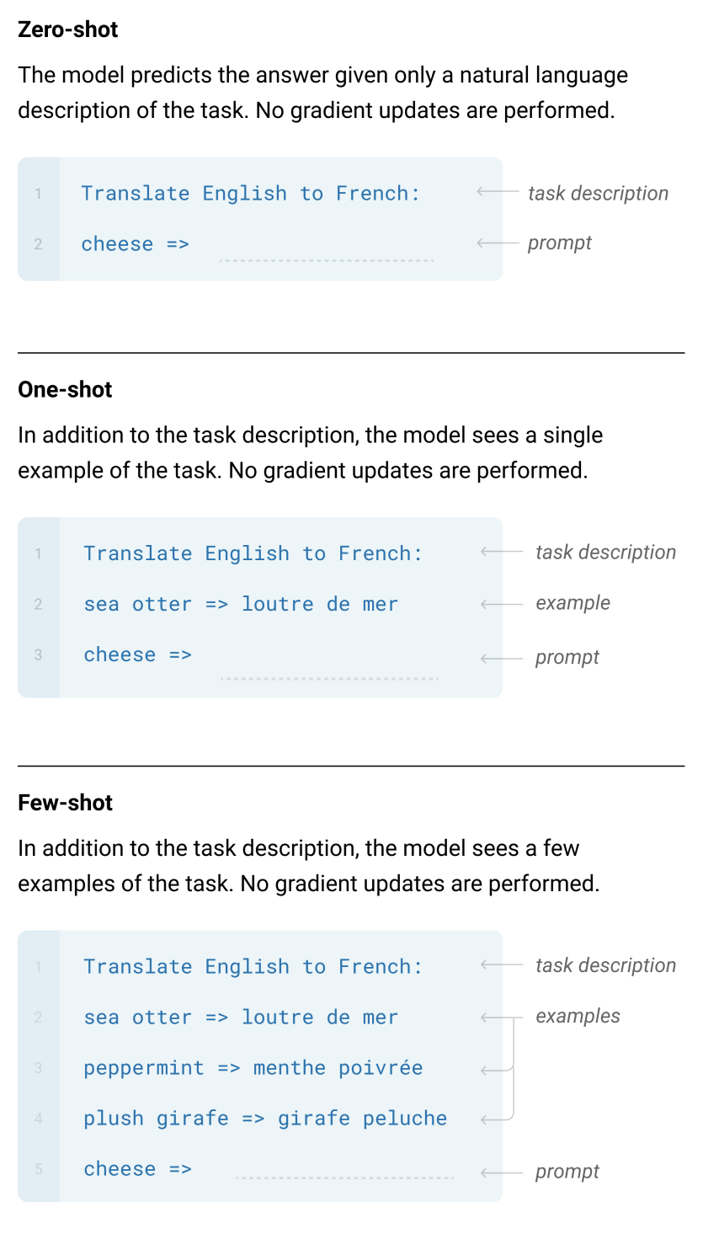
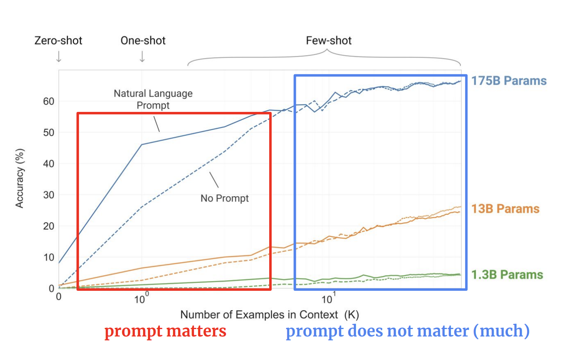
GPT-3: Language Models are Few-Shot Learners

Slide 20
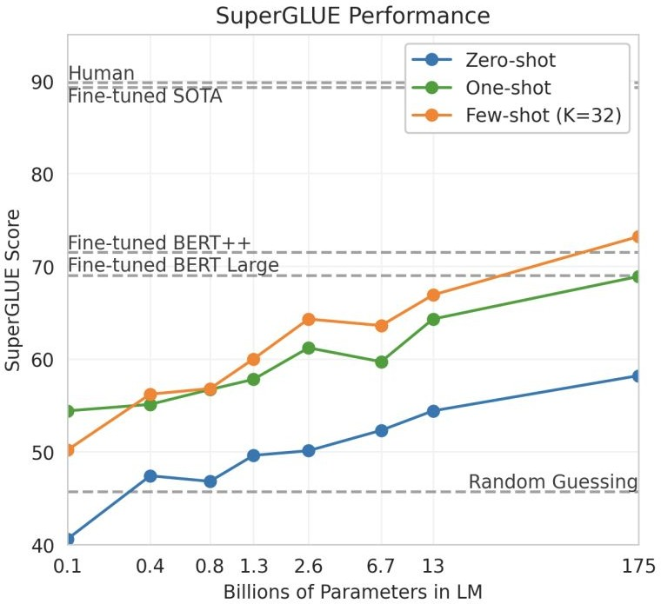
In-context learning results
Brown et al. 2020. “Language Models are Few-Shot Learners”

Slide 21
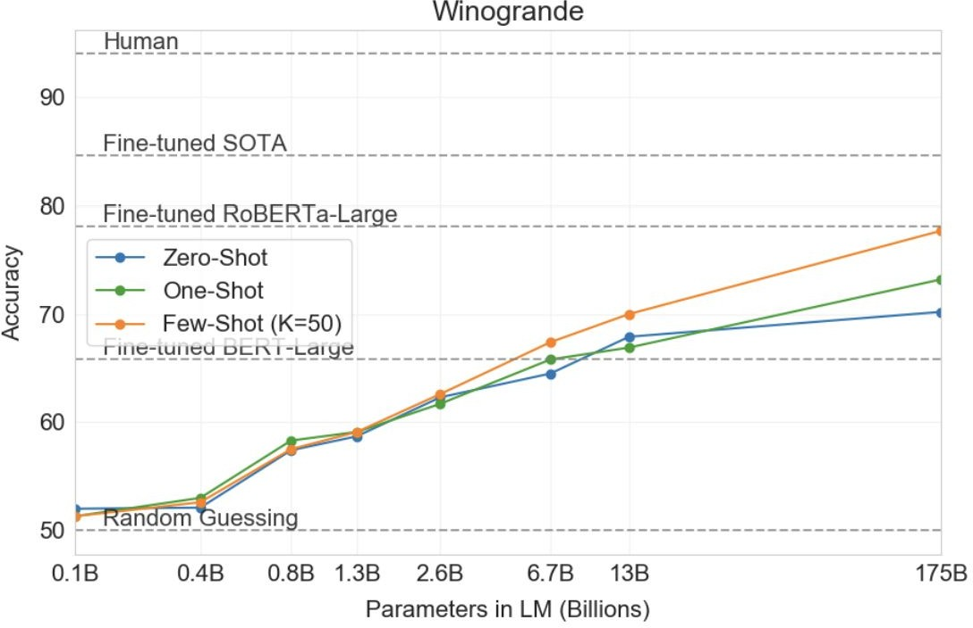
In-context learning results
Brown et al. 2020. “Language Models are Few-Shot Learners”

Slide 22
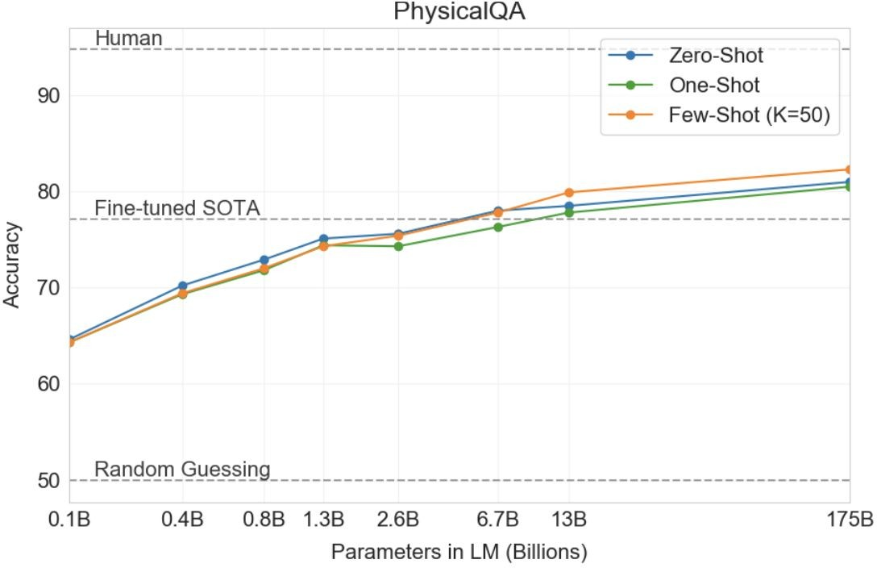
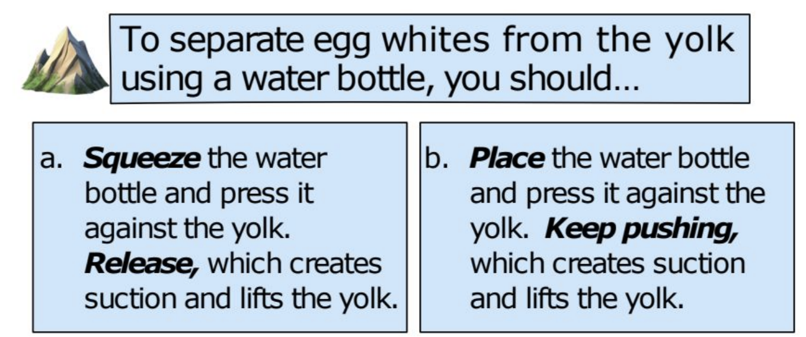
In-context learning results
Brown et al. 2020. “Language Models are Few-Shot Learners”

Slide 23
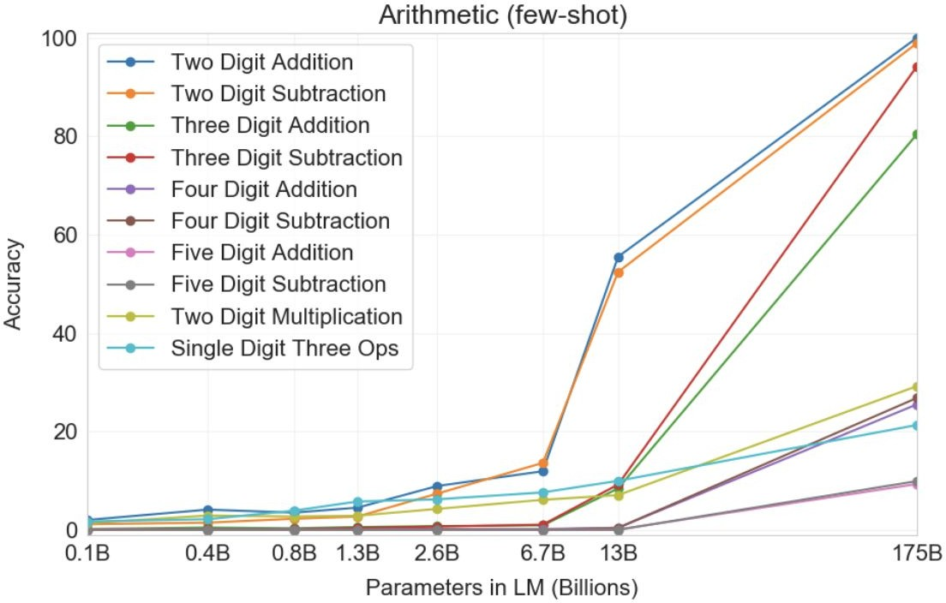
In-context learning results
Example:
Q: What is 48 plus 76?
A: 124
Observations:
Scale is important
Number of digits correlate with their difficulty.
Multiplication is harder than summation!
Brown et al. 2020. “Language Models are Few-Shot Learners”

Slide 24
The Phases of Our Understanding
“Language modeling is a useful subtask for many NLP tasks” – everyone, pre-2018
“Language modeling is a useful supertask for many NLP tasks” – everyone, post-2018

